Slide 1
BOUNTY HACKER: PENETRATION TESTING REPORT
Presented by: Elena Martín López

Slide 2
TABLE OF CONTENTS
01
PROJECT OVERVIEW
02
METHODOLOGY
03
WALKTHROUGH
04
TECHNICAL CHALLENGES
05
CONCLUSION
What is the project and why did I choose it
Structured approach used
Step-by-step process of executing the test
Issues faced and how they were addressed
Summary of the test results and key learning outcomes

Slide 3
01
PROJECT OVERVIEW

Slide 4
What and why
WHAT IS THE PROJECT?
WHY DID I CHOOSE IT?
A penetration test on the "Bounty Hacker" machine from TryHackMe.
Objective: Gain initial access, escalate privileges, and obtain root access while documenting the process.
Passion for ethical hacking and penetration testing.
Desired a challenge without a step-by-step guide, forcing me to figure out the approach independently.

Slide 5
02
METHODOLOGY

Slide 6
PENETRATION TESTING PHASES
RECONNAISSANCE
GAINING ACCESS
PRIVILEGE ESCALATION
Gather initial information about the system
Exploit vulnerabilities to gain user-level access
Elevate privileges to root access

Slide 7
03
WALKTHROUGH

Slide 8
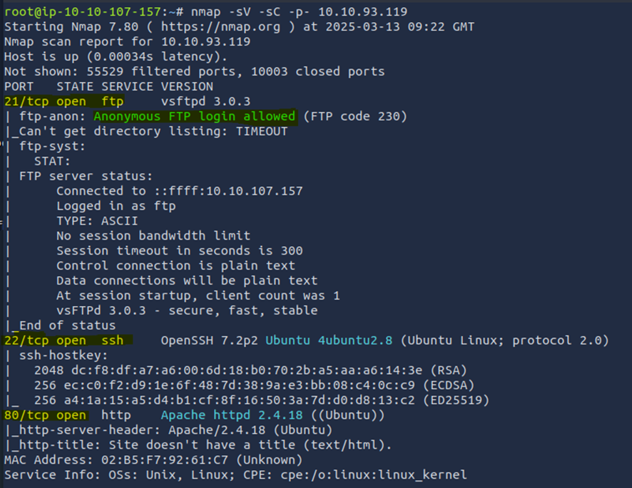
RECONNAISSANCE
TOOLS
COMMAND EXPLANATION
Nmap: to identify open ports and services running on the target system
-sV: Enables service version detection
-sC: to gather additional information
-p-: Scans all 65535 ports

Slide 9

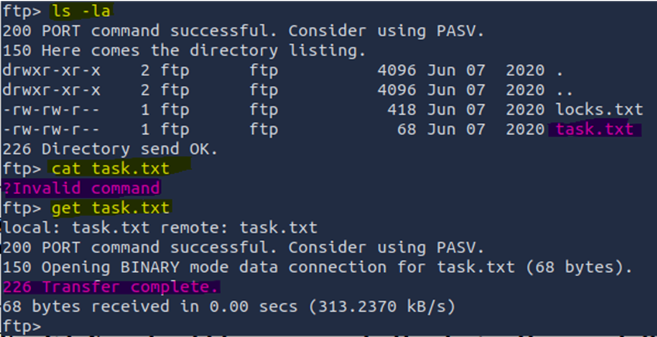

GAINING ACCESS
TOOLS
FTP: Accessed open FTP port, downloaded task.txt and locks.txt

Slide 10
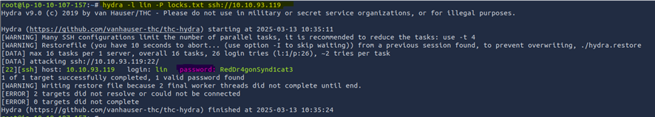
GAINING ACCESS
TOOLS
Hydra: Brute-force SSH access with locks.txt, obtained credentials for user “lin” (RedDr4gonSynd1cat3).

Slide 11
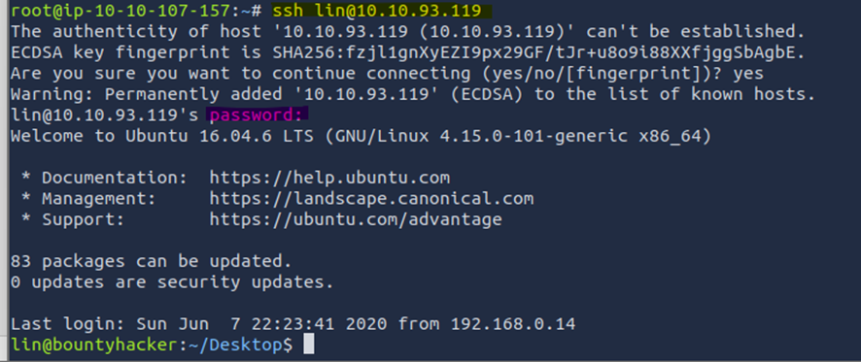
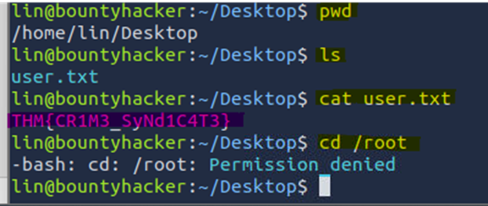
GAINING ACCESS
TOOLS
SSH: Access SSH using the user found and the password brute-forced with Hydra

Slide 12
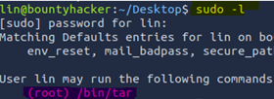
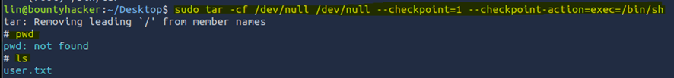
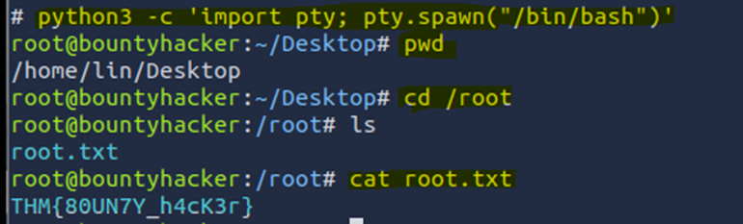
ESCALATE PRIVILEGES
TOOLS
sudo -l: to check available commands for privilege escalation
GTFObins: Found a command to escalate privileges
Python3: Stabilized shell

Slide 13
04
TECHNICAL CHALLENGES & MISTAKES

Slide 14
MAIN CHALLENGES
Wrong Wordlist: I used rockyou.txt instead of locks.txt for SSH brute-forcing at the beginning
Privilege Escalation: After using the GTFOBins commands, I successfully gained root access, but the shell was limited. I had to stabilize it using Python3 to ensure full functionality

Slide 15
05
CONCLUSION

Slide 16
SUCCESS
LEARNING
IMPROVE
Successfully completed the penetration test
Learned the importance of selecting the correct wordlist and stabilizing the shell for privilege escalation
Improved skills in reconnaissance, exploitation, and privilege escalation

Slide 17
THANK YOU!
Feel free to ask any questions!
Presented by: Elena Martín López

